Slide 1



Slide 2
Introduction to Access 2016- Part 2
Creating a database
Importing Excel data
Developing Tables
Datasheet Views and Design Views
How Access Saves Data

Slide 3
Download from Blackboard
Health Club Names for Access Practice Part 1 and Part 2 Excel Files

Slide 4
Importing Excel Data Into Access
Open a blank Access database
Choose External Data
Use Heath Club Names for Access Practice Excel Files
Click External Data tab
Choose Excel
Browse to Health Club Names for Access Practice Excel Files
Import into current Access database

Slide 5
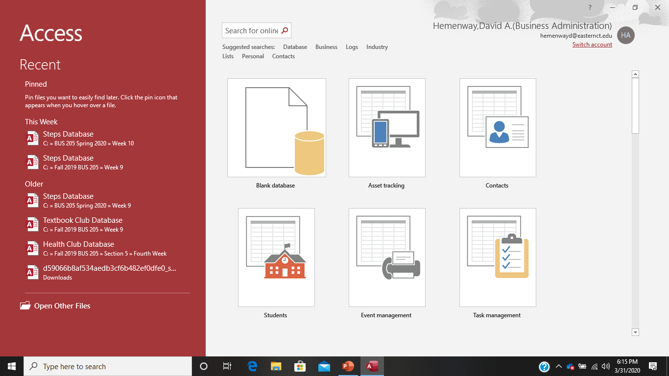
Step 1: Open Access

Slide 6
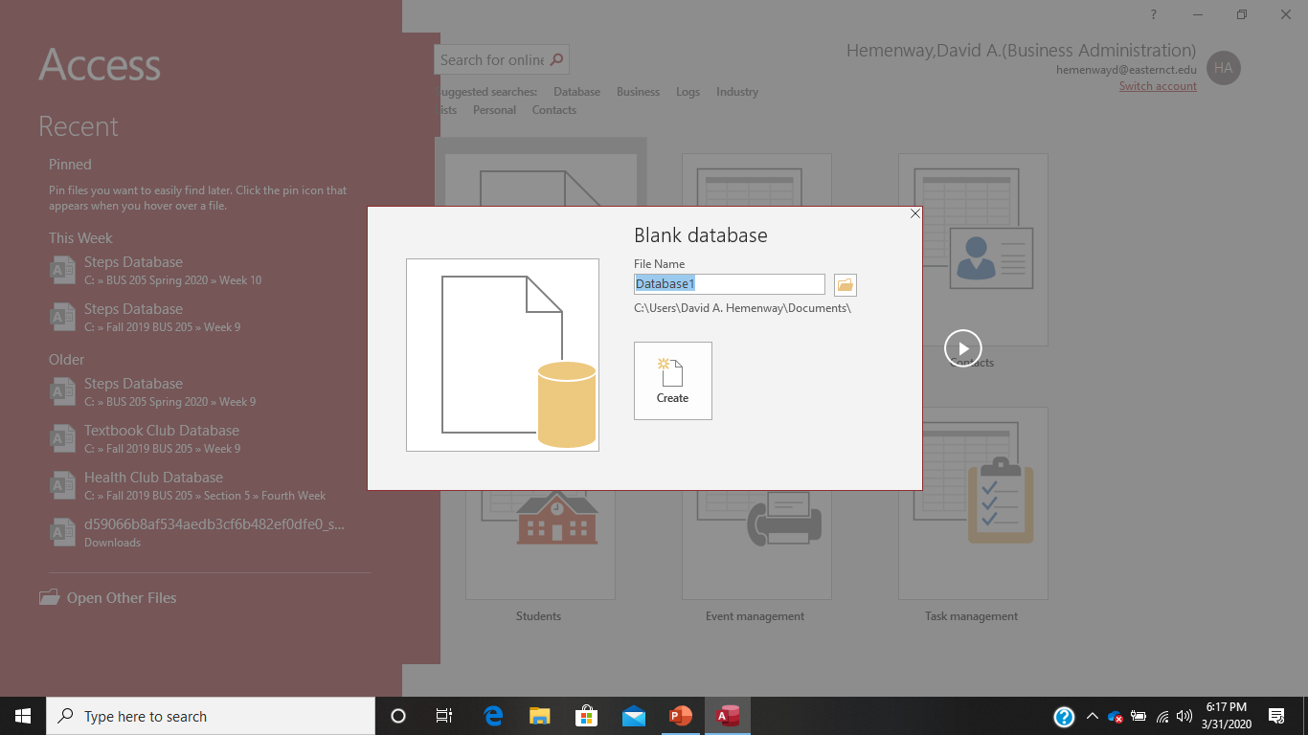
Step 2: Select a blank database and choose Create

Slide 7
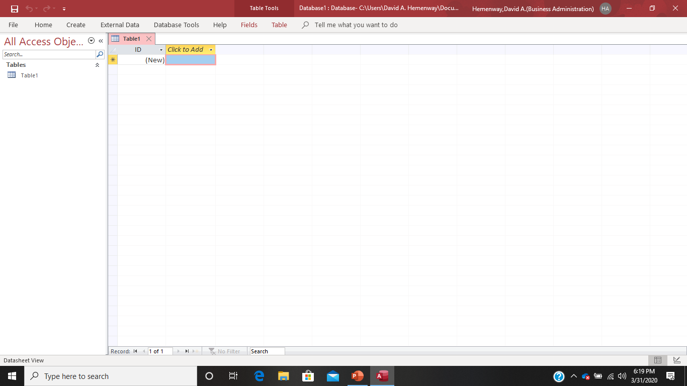
Step 3:

Slide 8
Step 4: Save your new database wherever you want it. Remember to select the location and name it “Health Club Members”

Slide 9
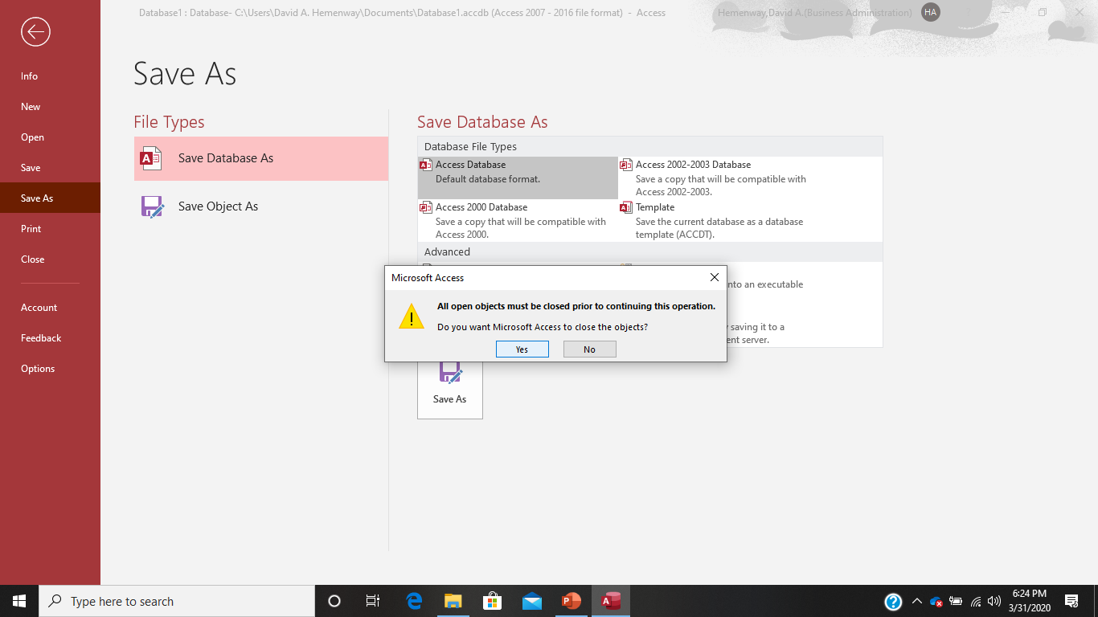
If you get this response, select Yes. Everything is fine!

Slide 10
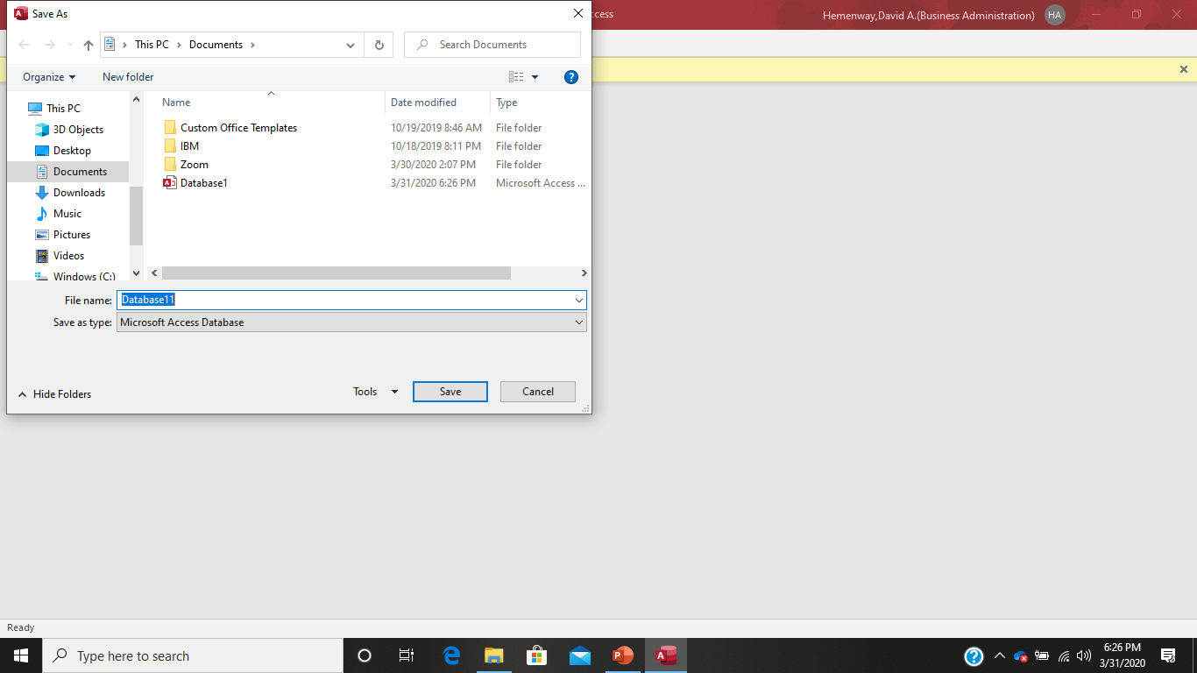
Notice that the default file location is your documents folder. Change this to wherever you want to keep your Access database files.

Slide 11
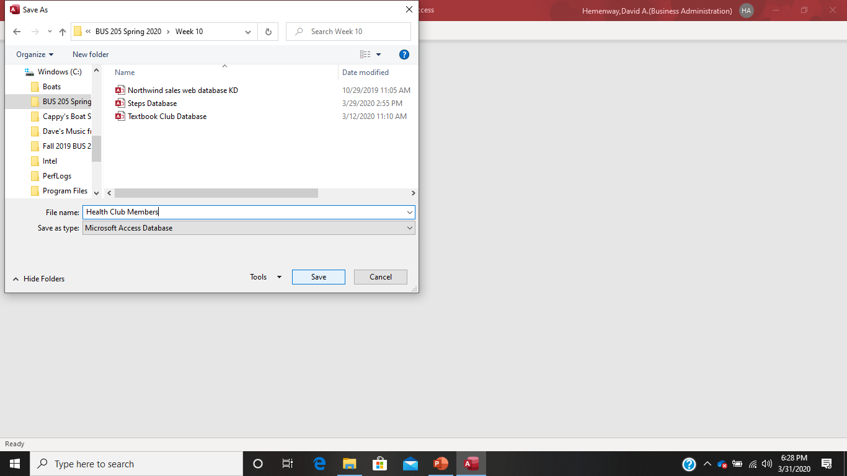
Here is where I put my “Health Club Members” Access database.

Slide 12

When you get this, select Enable.

Slide 13
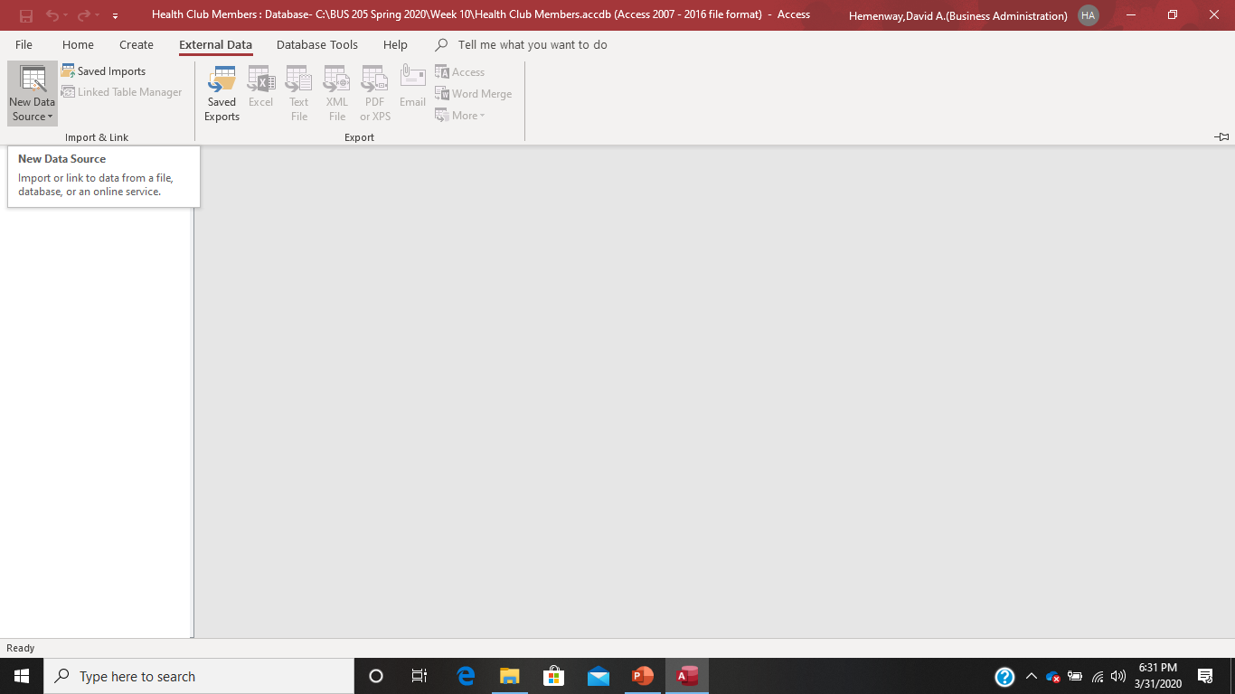
Step 5: Select External Data and choose New Data Source

Slide 14
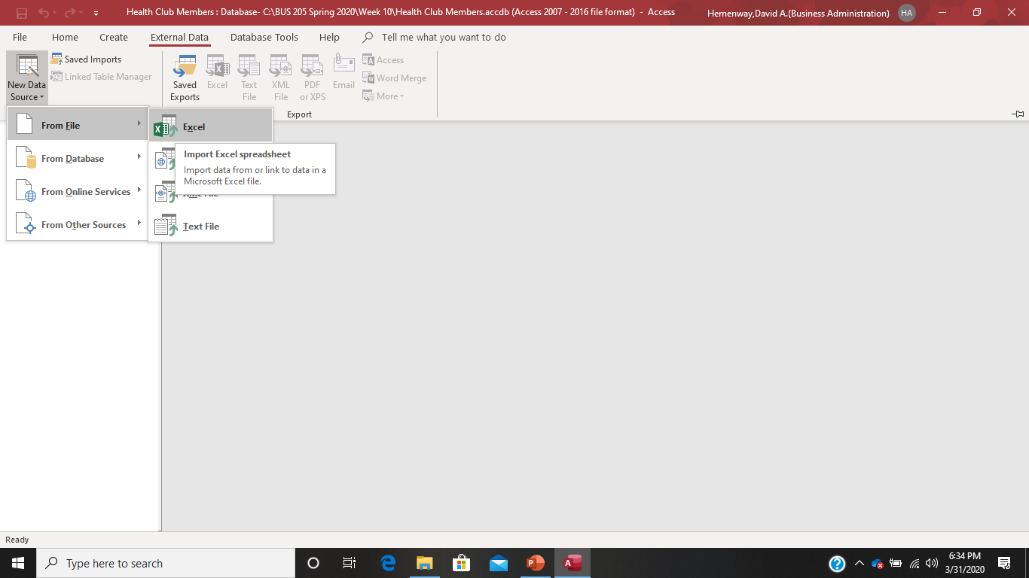
Step 6: Select From File and Choose Excel

Slide 15
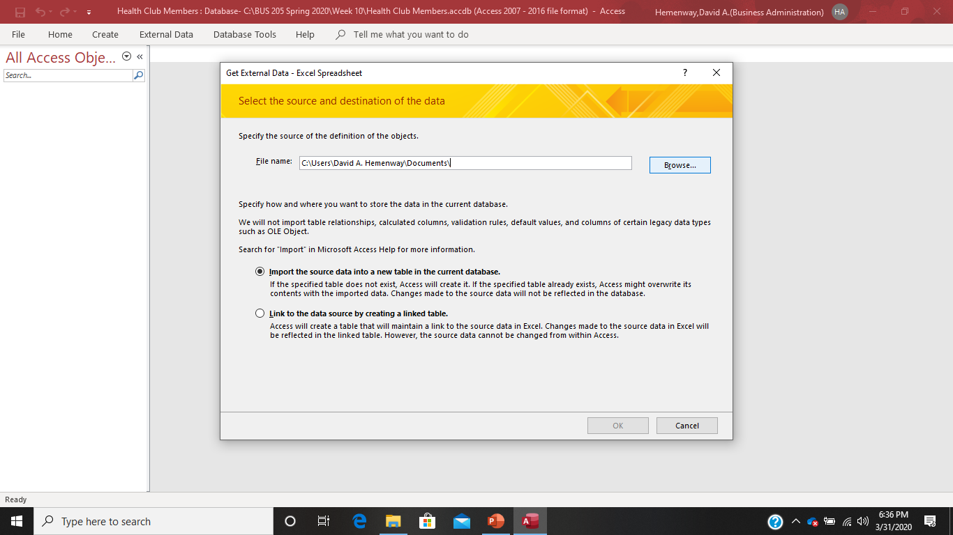
Step 7: Browse to where you put the two Health Club Members spreadsheets and select part 1

Slide 16
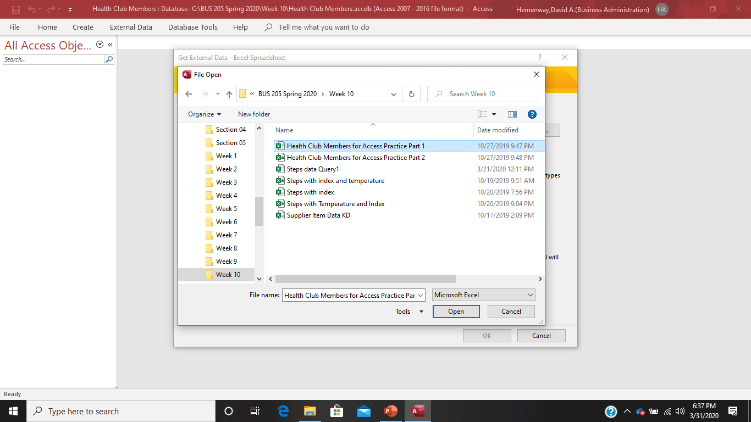
Open the Health Club Member for Access Practice Part 1 spreadsheet.

Slide 17
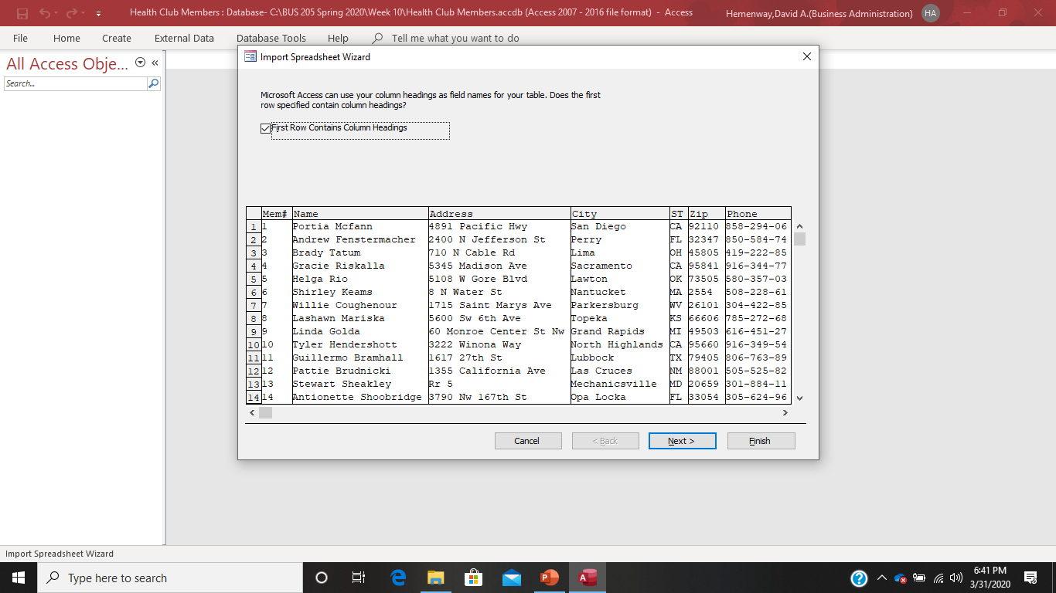
The result should be a screen that looks like this. Notice that Access said that the First Row Contains Column Headings. This is good! Select Next.

Slide 18
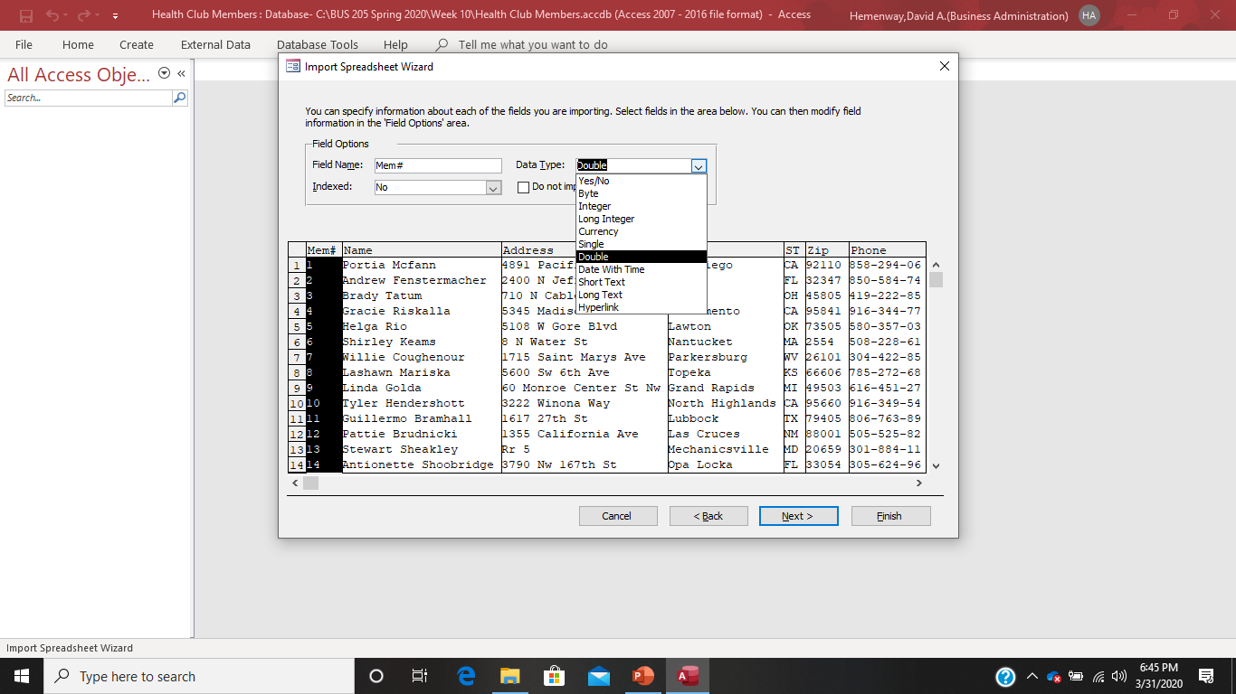
Step 8: Now you are going to determine whether you are going to import the column, and you are going to import all of them and determine the data type for each column (field). Choose a Data Type of Double and select Next.

Slide 19
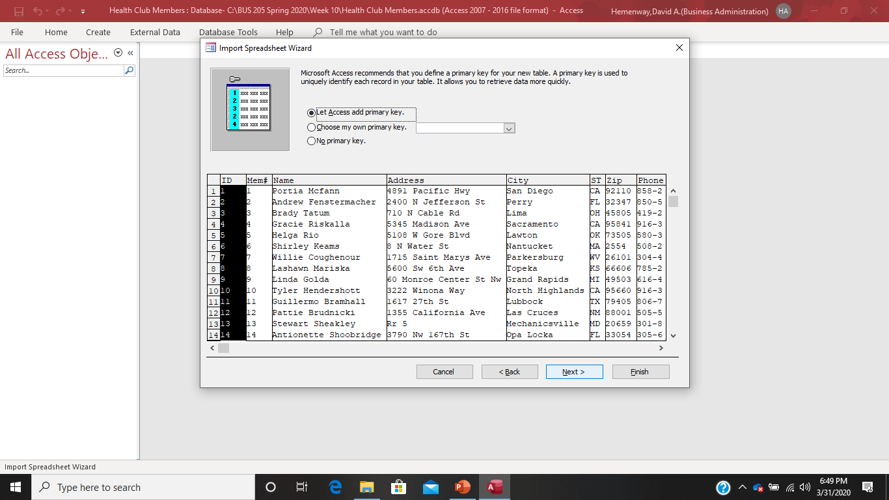
Step 9: Access will ask about a primary key select Choose my own primary key

Slide 20
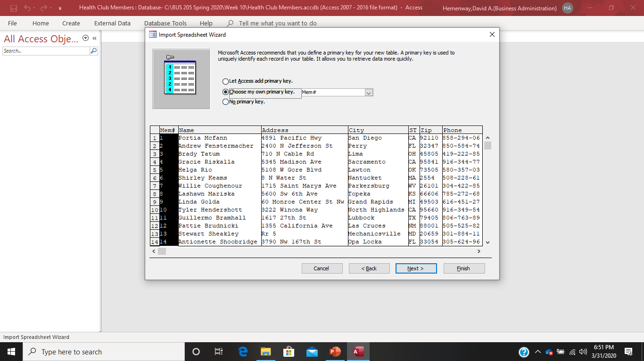
Mem# will appear and that is what you want. While you have other options using the down arrow key in this menu, leave Mem # and select Next

Slide 21
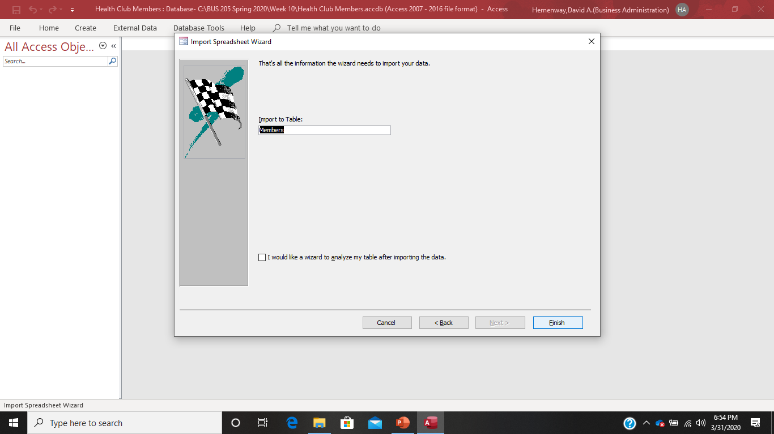

Slide 22
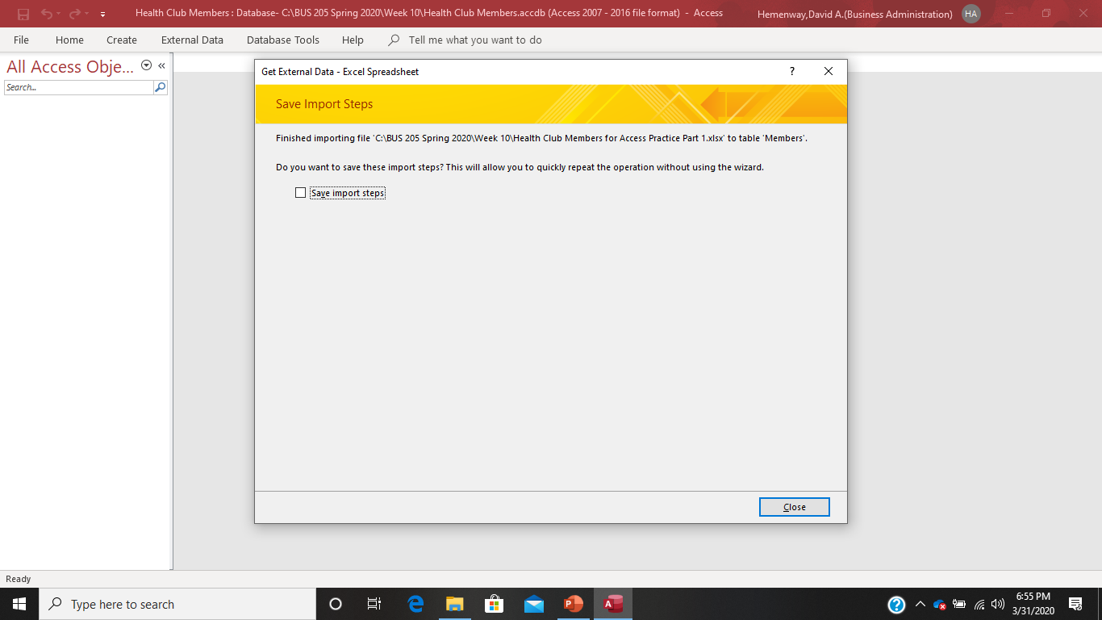
While you have the option to save the import steps, you don’t want to choose this for this simple import, just select Close

Slide 23
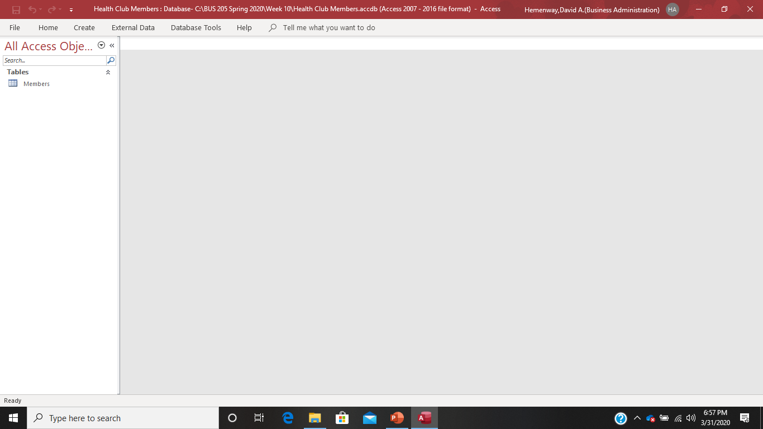
Now you have a Table called Members in your Access Database! Now click on Members and you can see your Members data.

Slide 24
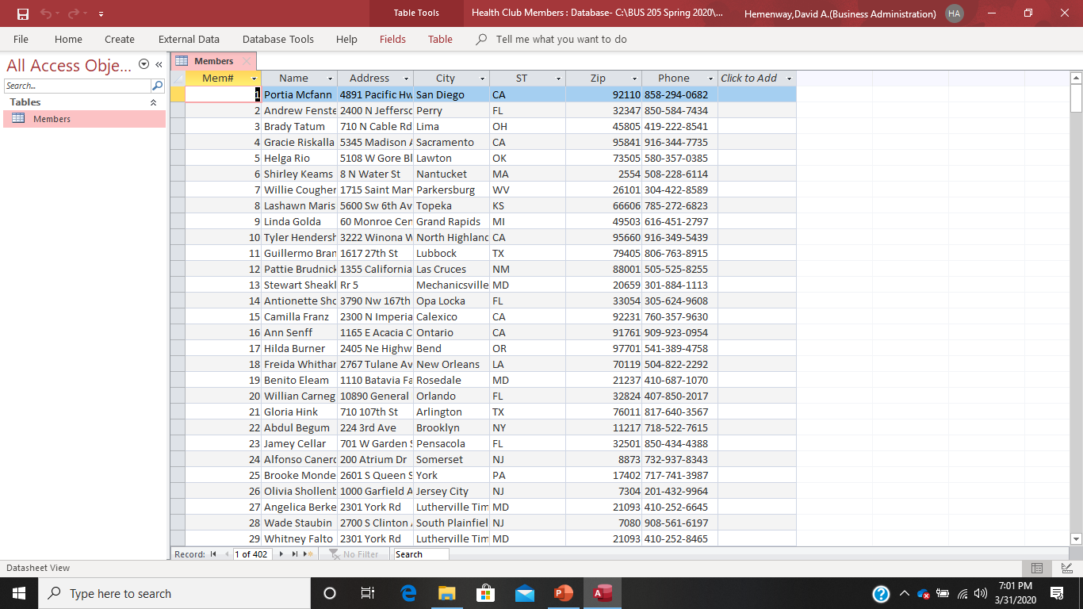
Now click on the X beside Members in the Members database to close this table

Slide 25
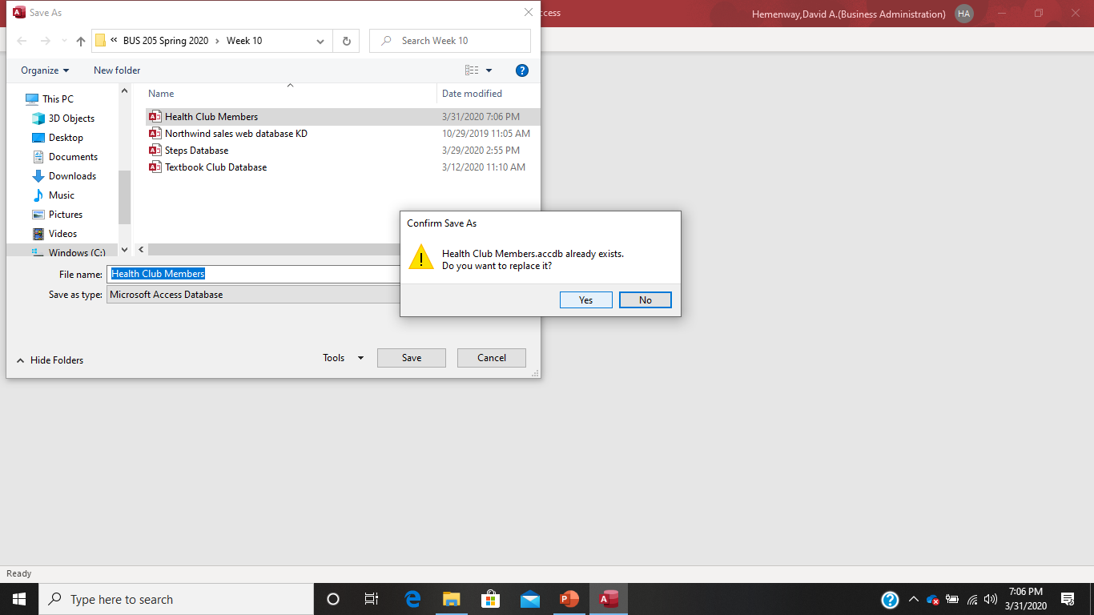
Step 10: Now save your Health Club Members database to make sure you don’t mess it up as you continue to work on it. Save it as the same name as your original.

Slide 26
Import the second part of the Health Club Members database.
Now go through the same ten steps to make a table for the second part of the Health Club Members database file which is the Dues and Payments sheet by importing the Excel spreadsheet. Make sure you make the column (field) Mem# the primary key. The following slides show these steps for you. Make sure you make everything EXACTLY as I have or your database will be messed up and will have to be recreated- which is no big deal, but best avoided!

Slide 27


Slide 28
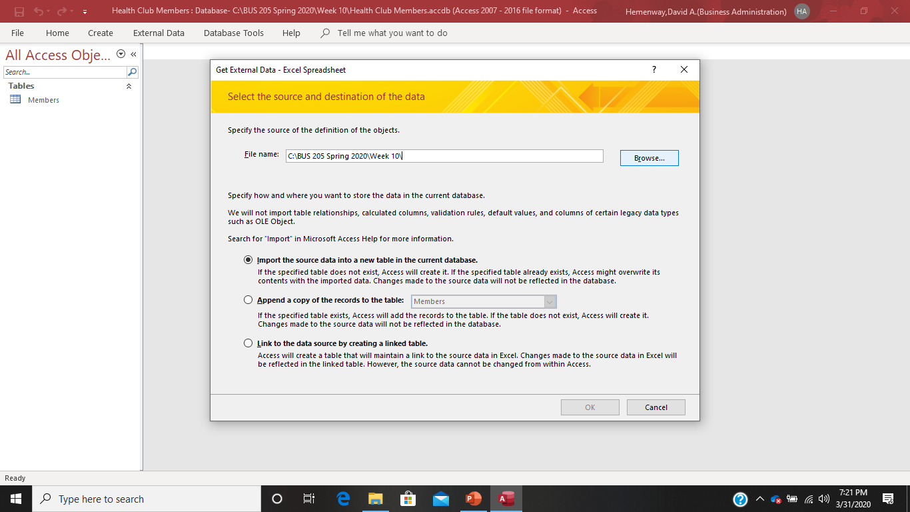

Slide 29
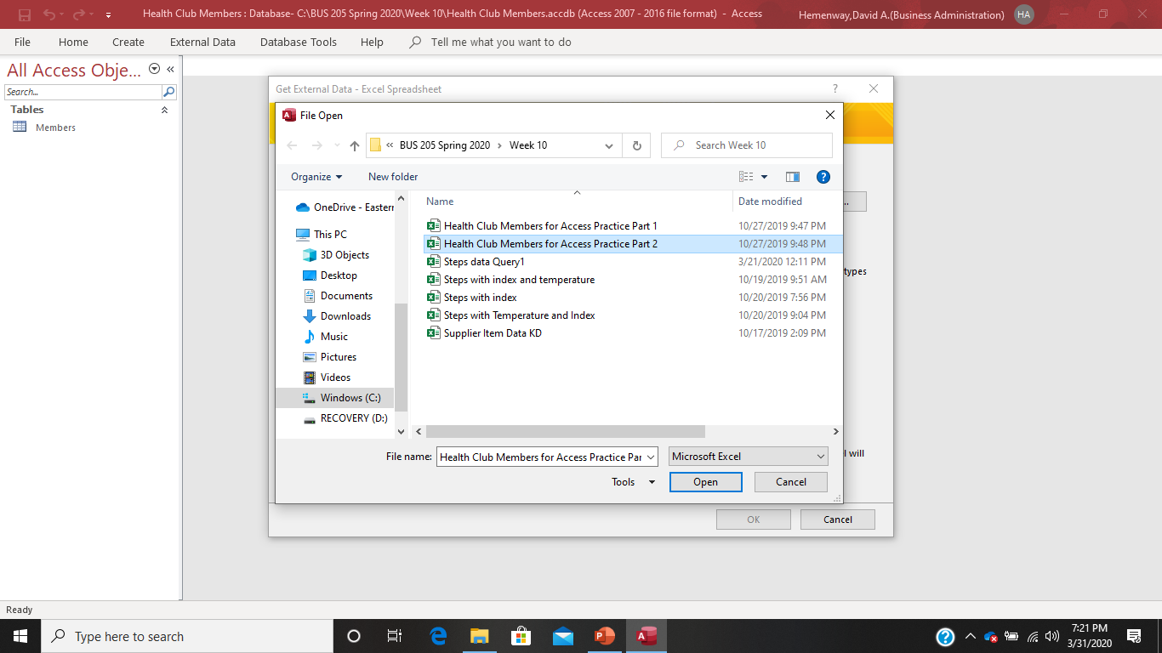

Slide 30
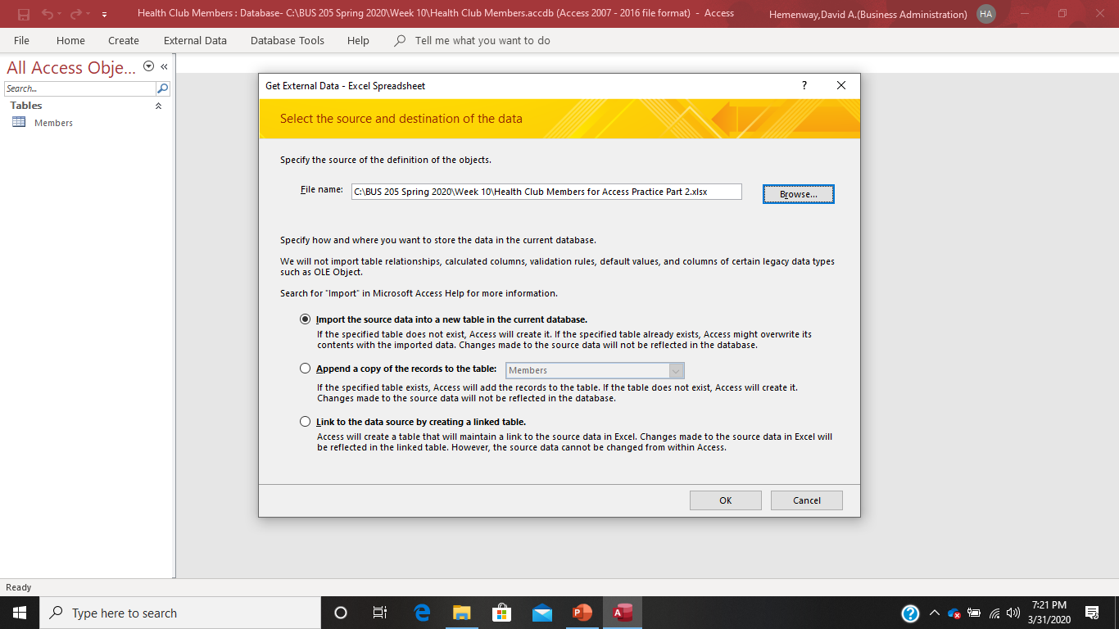

Slide 31
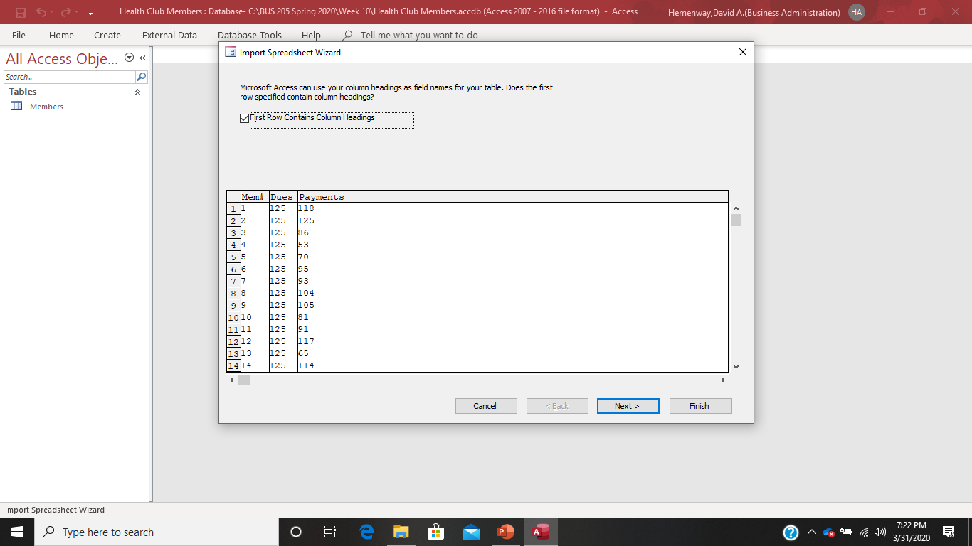

Slide 32
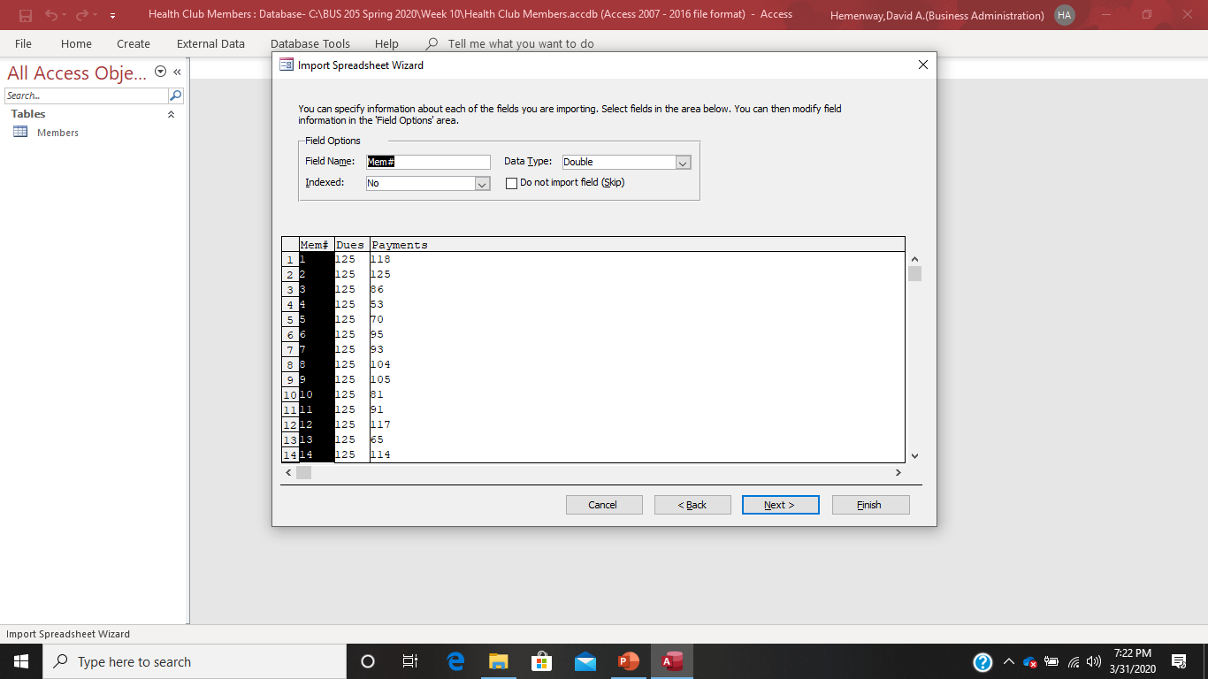

Slide 33
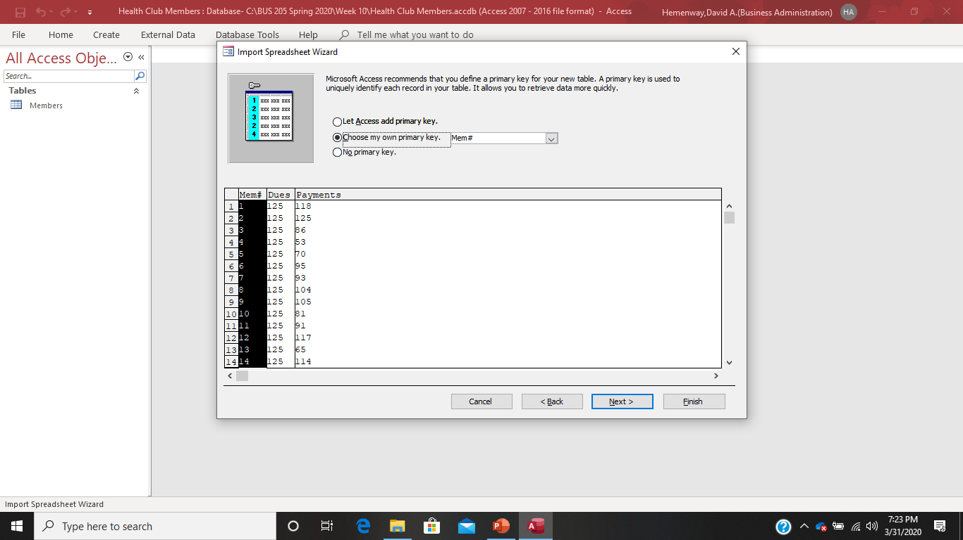

Slide 34

Make sure you change the Table name to “Dues and Payments”

Slide 35
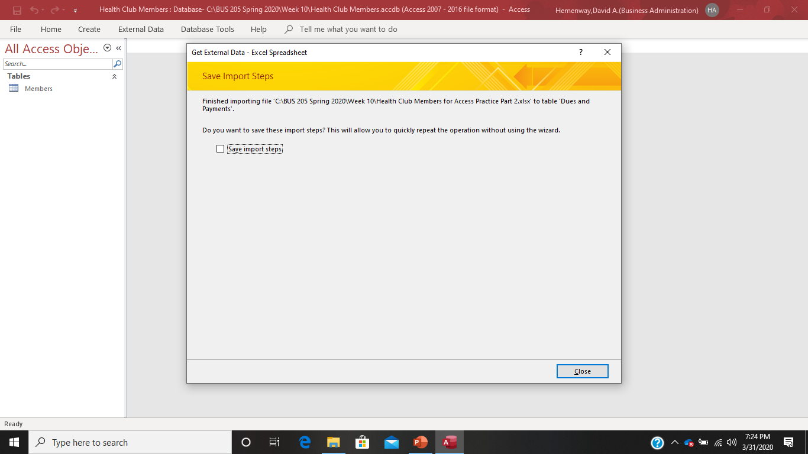

Slide 36

Your screen should now look like this:

Slide 37
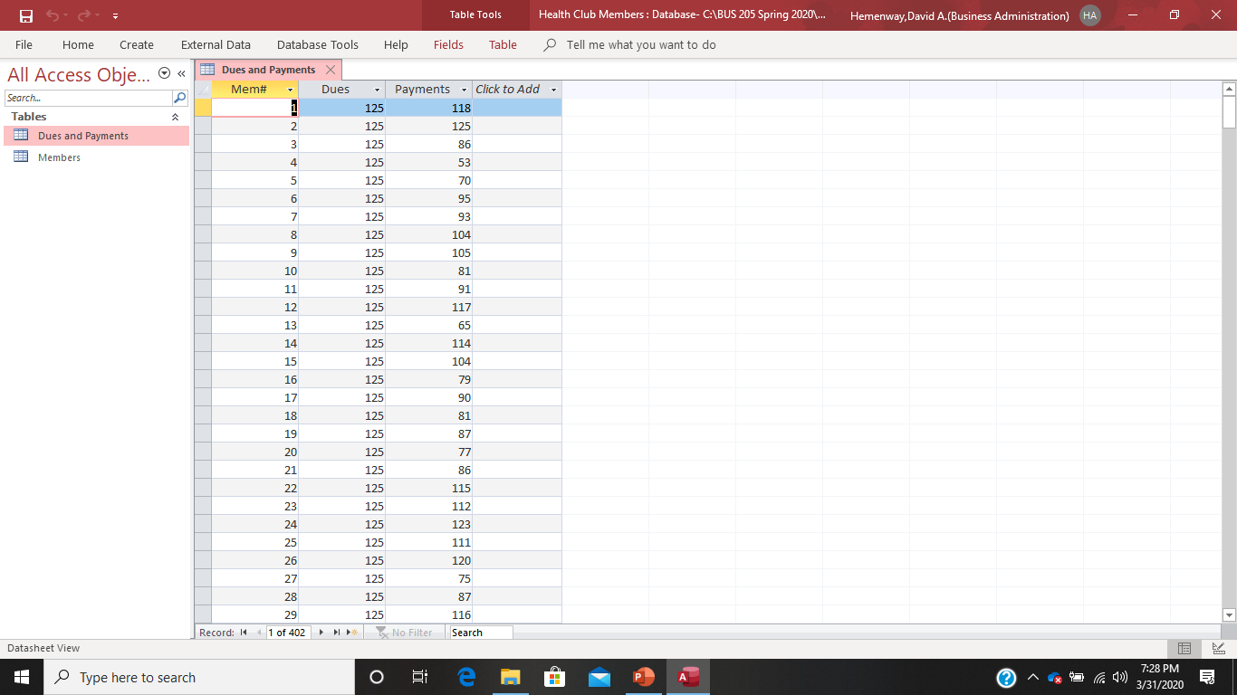
Double click on Dues and Payments to see your new table:

Slide 38
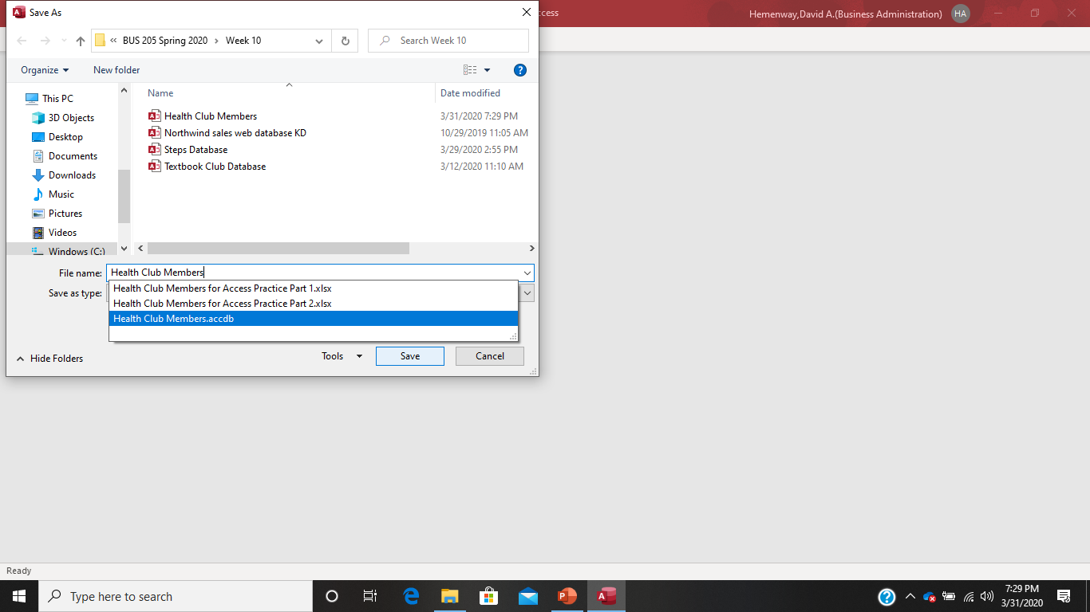
Now save your completed database before something happens to it.

Slide 39
Table Views
Databases provide “logical views” of data
Two major views for Access are datasheet and design
Datasheet is for viewing, adding and changing data
Design view is for creating or changing the structure of the database

Slide 40
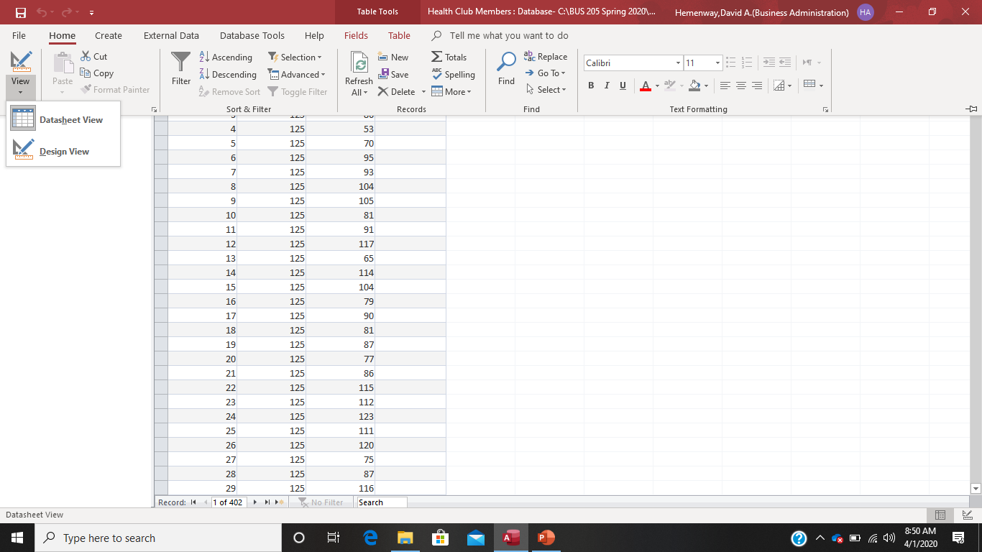
Switching from Data View to Design View

Slide 41
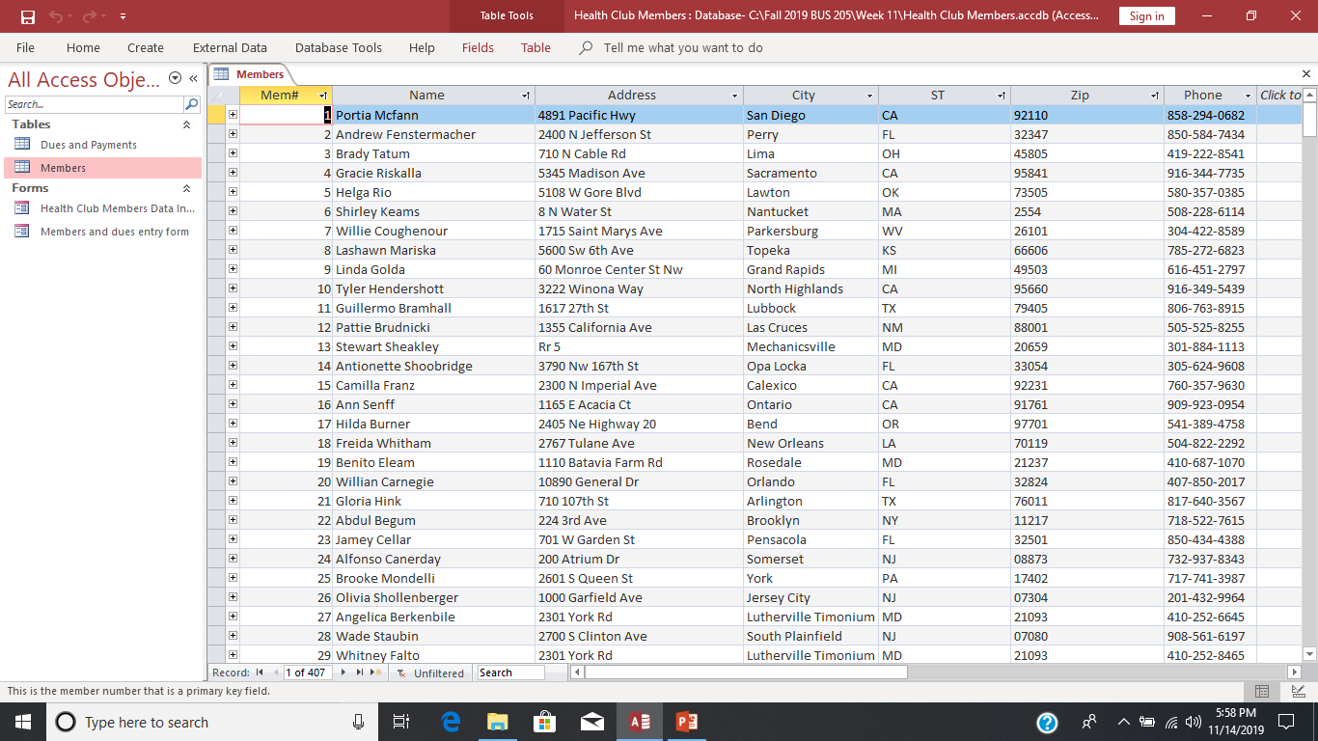
The table below is a datasheet view:

Slide 42
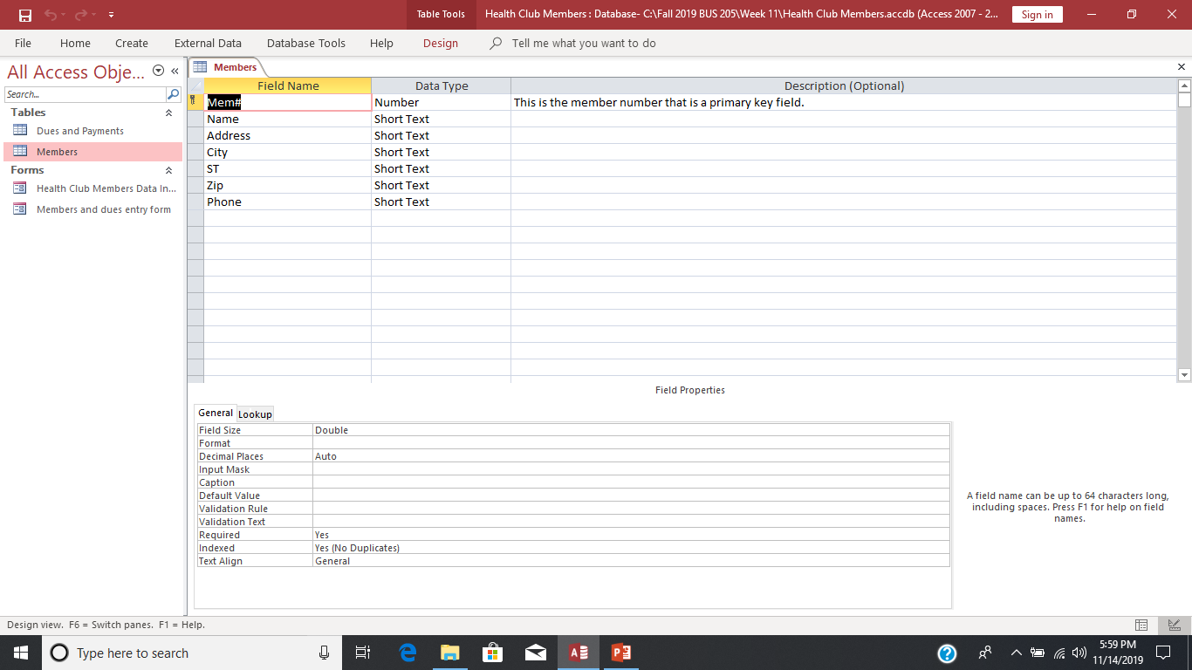
The table below is a design view

Slide 43
Closing a Table
Close a table by clicking its Close button on the object tab, as you did earlier
If you want to close the Access program as well, you can click the program’s Close button
When you do, any open tables are closed, the active database is closed, and you exit the Access Program

Slide 44
Saving a Table (file)
Records you enter are immediately stored in the database as soon as you enter them
However, the table’s design—the field names and characteristics of the fields themselves, plus any layout changes to the datasheet—are not saved until you save the table
When you save a new table for the first time, you should give it a name that best identifies the information it contains
Like a field name, a table name can contain up to 64 characters, including spaces

Slide 45
Saving a Table
Note: The default for Access when saving a file is the documents folder on your computer. You MUST use “file save as” to change this to your preferred location.

Slide 46
Saving Access Files
Access generally saves two files every time you save a database.
One ends in laccdb. This is a small record locking file and should be ignored for this class.
Please DO NOT UPLOAD THIS FILE FOR A QUIZ OR TEST.
The other is a large file ending in .ACCDB. That is the database. This is the file you upload when you are requested to upload an Access file.
Access Database (2007, 2010, 2013, 2016, 2019) | .accdb
Access Record-Locking Information (2007, 2010, 2013, 2016) | .laccdb

Slide 47
Opening a Table
The tables in a database are listed in the Navigation Pane. You open a table, or any Access object, by double-clicking the object name in the Navigation Pane

Slide 48
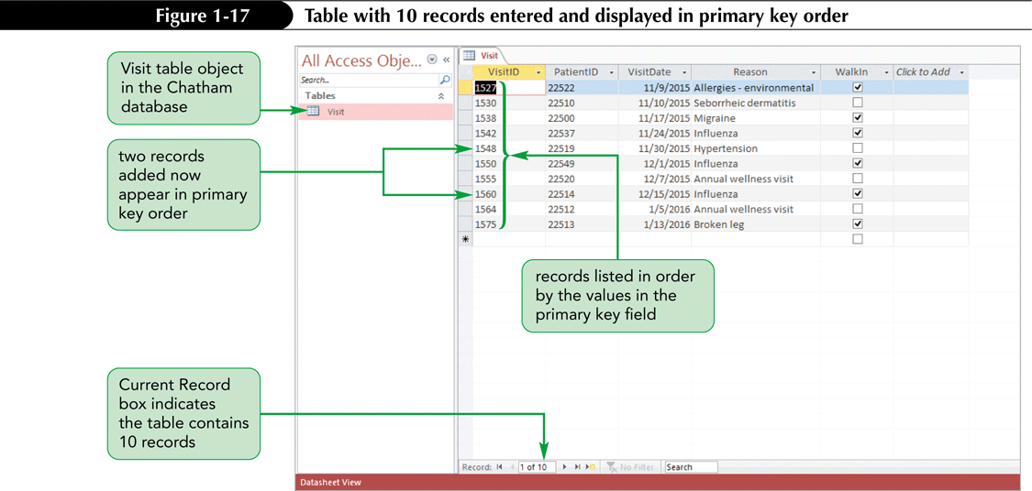
Opening a Table
The tables in a database are listed in the Navigation Pane. You open a table, or any Access object, by double-clicking the object name in the Navigation Pane

